Slide 1
C H A P T E R 15 Thermodynamics

Slide 2
The Second Law of Thermodynamics
Heat flows spontaneously from a substance at a higher temperature to a substance at a lower temperature and does not flow spontaneously in the reverse direction.
https://www.youtube.com/watch?v=mGDJO2M7RBg&list=PLbnrZHfNEDZxmZmL3fZHPTeoUO8amBox2&index=3

Slide 3
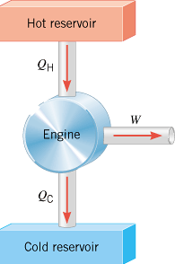
Heat Engine
A heat engine is any device that uses heat to perform work. It has three essential features:
1. Heat is supplied to the engine at a relatively high temperature, hot reservoir.
2. Part of the input heat is used to perform work by the working substance of the engine, which is the material within the engine that actually does the work.
3. The remainder of the input heat is rejected at a temperature lower than the input temperature to a place called the cold reservoir.
Q_{H} = Q_{C} + W

Slide 4
Efficiency,e of a Heat Engine
Q_{H} = Q_{C} + W
Q_{H} - Q_{C} = W
$$e=\frac{W}{Q_{H}}=\frac{Q_{H}−Q_{C}}{Q_{H}}=1−\frac{Q_{C}}{Q_{H}}$$

Slide 5
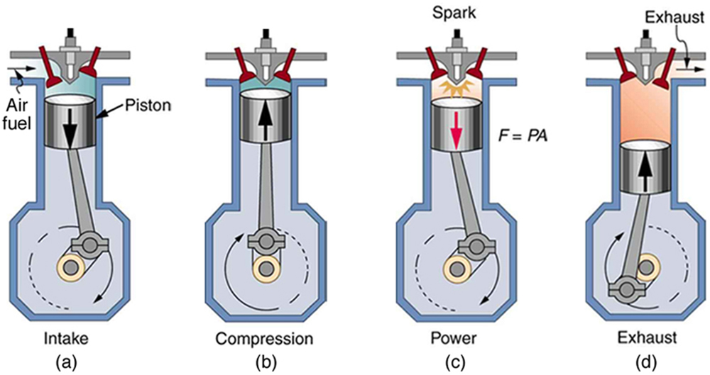
Four-stroke internal combustion gasoline engine
(a) Air is mixed with fuel during the intake stroke. (b) During the compression stroke, the air-fuel mixture is rapidly compressed in a nearly adiabatic process, as the piston rises with the valves closed. Work is done on the gas. (c) The power stroke has two distinct parts. First, the air-fuel mixture is ignited, converting chemical potential energy into thermal energy almost instantaneously, which leads to a great increase in pressure. Then the piston descends, and the gas does work by exerting a force through a distance in a nearly adiabatic process. (d) The exhaust stroke expels the hot gas to prepare the engine for another cycle, starting again with the intake stroke.

Slide 6
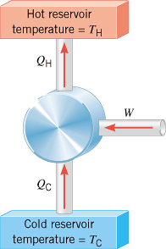
Refrigerators and Air Conditioners
In a refrigeration process, work W is used to remove heat Q_{C} from the cold reservoir and deposit heat Q_{H} into the hot reservoir.

Slide 7
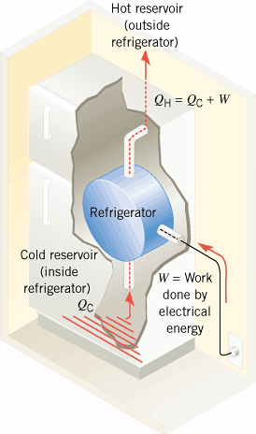
Refrigerator

Slide 8
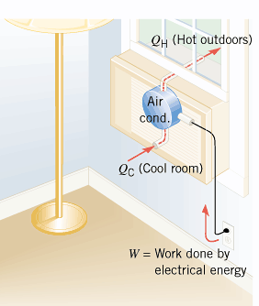
Air Conditioner

Slide 9
Coefficient of Performance
For a refrigerator or air-conditioner, the coefficient of performance is given by,

Slide 10
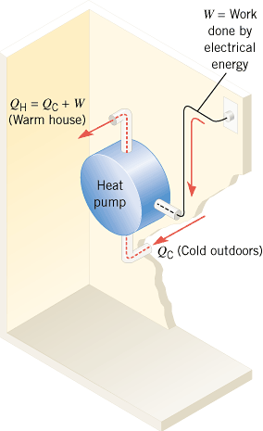
Heat Pump
https://www.youtube.com/watch?v=dDQgOvmSXCE

Slide 11
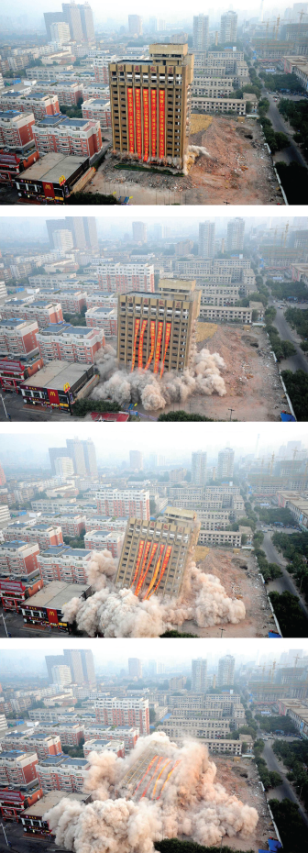
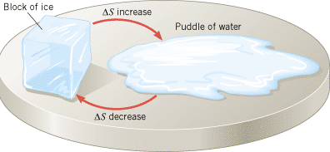
Entropy, S
A thermodynamic quantity representing the unavailability of a system's thermal energy for conversion into mechanical work.
A degree of disorder or randomness in the system.
Change in entropy is defined as follows,
https://www.youtube.com/watch?v=jHbuu287uxc

Slide 12
Change in Entropy
Find the change in entropy of 1.50 kg of liquid nitrogen that starts at its boiling temperature, 77.35K and boils. L_{v}=201x10³Kg, for liquid nitrogen.

Slide 13
The Third Law of Thermodynamics
It is not possible to lower the temperature of any system to absolute zero in a finite number of steps.
https://www.youtube.com/watch?v=kswiDQ2aAKA&index=4&list=PLbnrZHfNEDZxmZmL3fZHPTeoUO8amBox2

Slide 14
Coefficient of Performance (COP)
Heat Pump | $$COP=\frac{Q_{H}}{W}$$
Refrigerator or Air Conditioner | $$COP=\frac{Q_{C}}{W}$$
P70, CJ10. The wattage of a commercial ice maker is 225 W and is the rate at which it does work. The ice maker operates just like a refrigerator and has a coefficient of performance of 3.60. The water going into the unit has a temperature of 15.0°C, and the ice maker produces ice cubes at 0.0°C. Ignoring the work needed to keep stored ice from melting, find the maximum amount (in kg) of ice that the unit can produce in one day of continuous operation.

